Slide 1
CS487-Introduction to competitive programming: A2SV
Lecture #16 Topological Sort, Tries

Slide 2
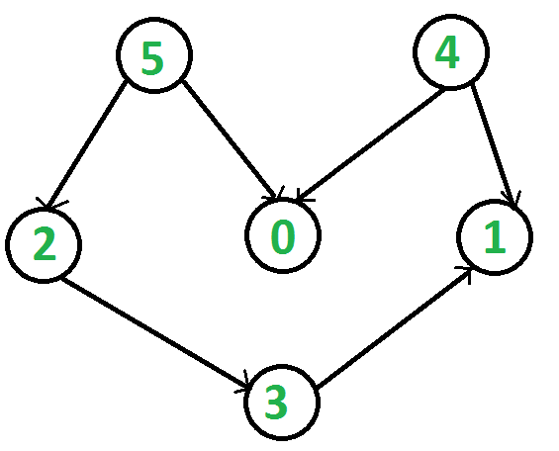
Topological Sort
Defined on Directed Acyclic Graphs(DAG)
Ordering of nodes such that for every edge u->v, u comes before v
Check if the following ones are topologically correct or not
5-4-2-0-1-3
4-5-0-2-3-1
4-5-2-3-1-0
Common application: Prioritization, Curriculum building, job scheduling

Slide 3
Finding Topological Sort- Approach I - I
Which nodes are safest to start execution from?
How can we detect them?

Slide 4
Finding Topological Sort- Approach I - II
Which nodes are safest to start execution from?
Nodes with no incoming edges
How can we detect them?
We can traverse over each edge, and keep track of incoming edge count for each node

Slide 5
Finding Topological Sort- Approach I - III
Finding incoming edge counts for adjacency matrix
for each node in Nodes {
indegree[node] = 0;
}
for each edge(src,dest) in Edges {
indegree[dest]++;
}
Finding incoming edge counts for adjacency list
for each node in Nodes {
for each dest in list[node] {
indegree[dest]++;
}
}

Slide 6
Finding Topological Sort- Approach I - IV
Start traversing the graph from nodes with no incoming edges, using BFS
// Assuming each node id is an int
vector<int> top_sort;
for each node in Nodes {
if(!indegree[node]) {
que.push(node);
top_sort.push_back(node);
}
}

Slide 7
Finding Topological Sort- Approach I - V
Insert nodes to the queue as they run out of indegree, add them to the result once they are processed
while(!que.empty()) {
int curr = que.front();
que.pop();
top_sort.push_back(curr);
for each node in list[curr] {
if(--indegree[node] == 0) {
que.push(node);
}
}
}
return top_sort;

Slide 8
Finding Topological Sort- Approach II - I
What if we go as deep as we can go?
We will end up at 0 or 1
Push a node into a vector if it doesn’t have any more unvisited children

Slide 9
Finding Topological Sort- Approach II - II
Start DFS from each unvisited node
Traverse a child if it’s not visited yet
Add yourself to the result vector if you don’t have any unvisited children left
Reverse the result vector

Slide 10
Programming Exercises
TODO(Emre): Add problems

Slide 11
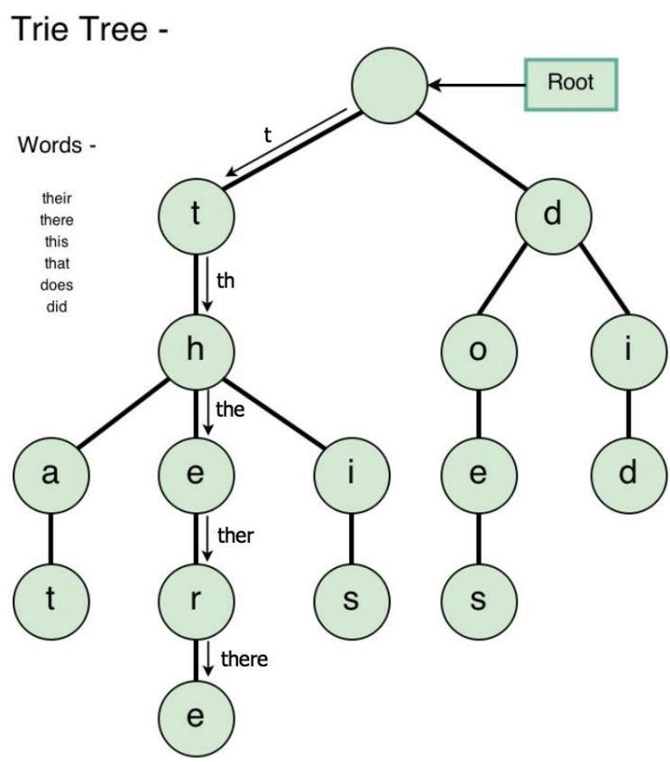
Tries
A data structure for efficient insertion, deletion, and search
Each node has a letter
Need to mark end of the words too
Insertion cost?
Deletion cost?
Search cost?

Slide 12
Tries
L is the average length of a word
Insertion = O(L)
Deletion = O(L)
Search = O(L)

Slide 13
Trie Node
// Trie node
struct TNode
{
struct TNode *children[ALPHABET_SIZE];
bool isEndOfWord;
};

Slide 14
Trie Insertion
void insert(struct TNode *root, string word) {
struct TNode *curr = root;
for (int i = 0; i < key.length(); i++) {
int index = key[i] - 'a';
if (!curr->children[index]) {
curr->children[index] = getNode();
}
curr= curr->children[index];
}
// mark last node as leaf
curr->isEndOfWord = true;
}

Slide 15
Trie Retrieval
// Returns true if the word is in trie
bool search(struct TNode *root, string word)
{
struct TNode *curr = root;
for (int i = 0; i < key.length(); i++) {
int index = key[i] - 'a';
if (!curr->children[index]) {
return false;
}
curr = curr->children[index];
}
return (curr != NULL && curr->isEndOfWord);
}

Slide 16
Programming Exercises
TODO(Emre): Add problems

Slide 17
Quote of the day
"You attract what you are, not what you want. If you want great, then be great."

